Slide 1
Exploring Curriculum Learning -Approaches to Reinforcement Learning
Fu, Rayhan, Luke, Jack

Slide 2
Student scenario
Task : Differentiate F(x)=2x².
Surely the student can solve it. Given Infinite time...

Slide 3
Student scenario
First Task
  1+1=2
Intermediate Task
  X+2 = 5
Target Task
  F(x) = 2x²

Slide 4
What is Curriculum Learning
Curriculum learning at its core is about gradually and appropriately increasing the difficulty of the environment and ensuing tasks such that the model is optimally challenged.
This is how humans learn. We progress from relatively easy concepts, such as addition/subtraction, to multiplication/division and then eventually algebra
The aim of this project is to implement curriculum learning within the multi-agent OpenAI environment

Slide 5
Curriculum learning - element
task generation – create multiple intermediate tasks
Sequencing – sequence the tasks
transfer learning – transfer knowledge from task to task

Slide 6
Autocurricula
Introducing multiple agents in an environment already generates a curriculum automatically
The actions of the new agents increase the complexity of the environment and encourage further learning
Example - single player solitaire vs two players leading to the game of Go (next slide)

Slide 7


Slide 10
OpenAI Environment
Explain the hide and seek concept
Seekers and hiders rewarded by finding/hiding from hiders/seekers respectively
Explain the action space
  Move blocks, lock boxes so they can’t be used by other team
  Ramp surf to go over walls
Video of environment -
https://www.youtube.com/watch?v=WY4mTBrboPg

Slide 11

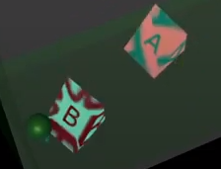

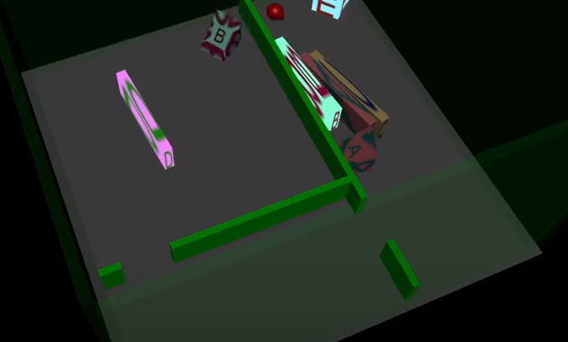


Movable walls
Movable ramps
Movable blocks
Immovable walls
Agents i.e hider and seeker

Slide 12
Progress
Background reading - very complex topics including
  Curriculum learning
  OpenAI environment and their work
Set up the Reinforcement Learning OpenAI environment
Installing MuJoCo
Created some environments
  Varying complexity
    Boxes
    Ramps
    Wall placement

Slide 13
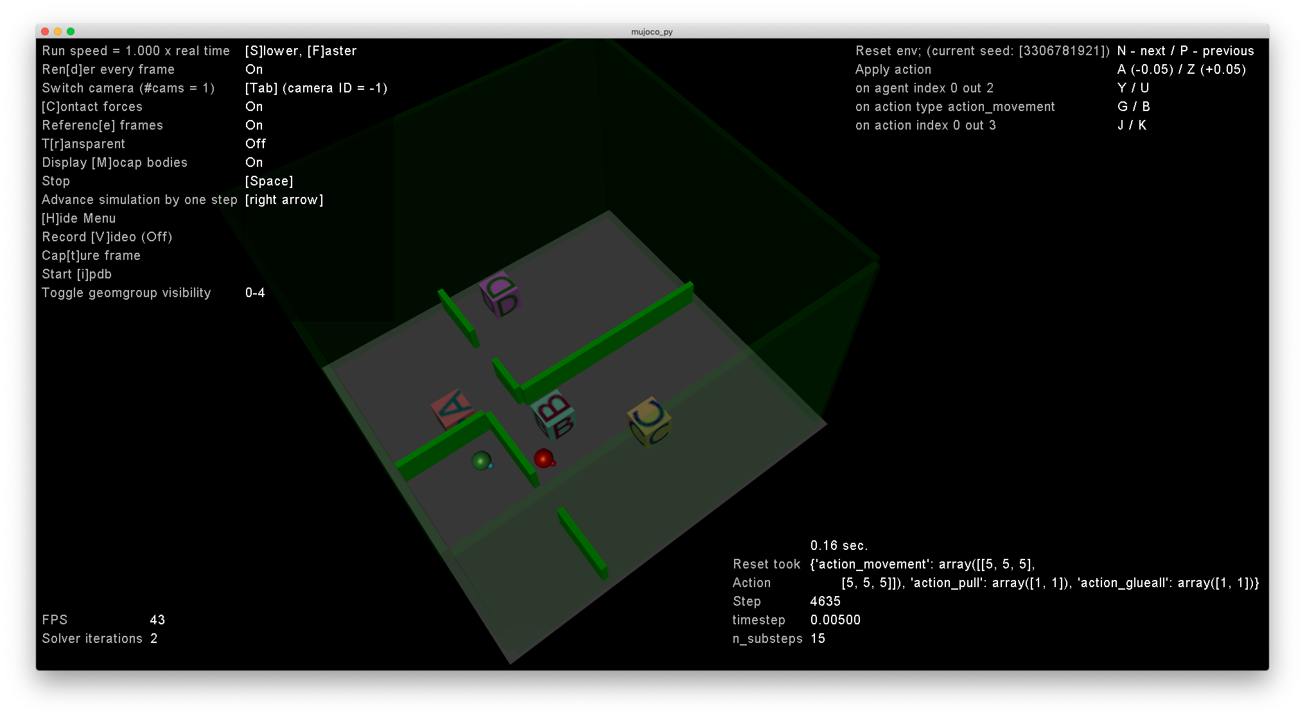

Slide 14
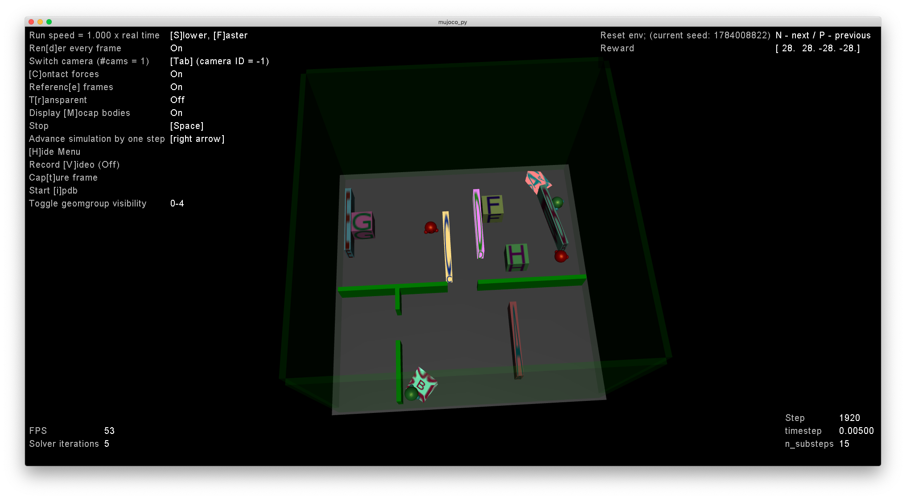

Slide 15
Plan to Completion
Deeper research into further curriculum learning studies
  To aid in curriculum generation
Vary levels of environmental complexity
  Creating more environments
Vary levels of opponent difficulty
  Agents seeded with policies of various phases of expertise within the environment
Measure time to convergence
  Time for sufficient policy advancement (entering a new phase of policy)
Time for Policy Transition between phases (OpenAI method)

Slide 16
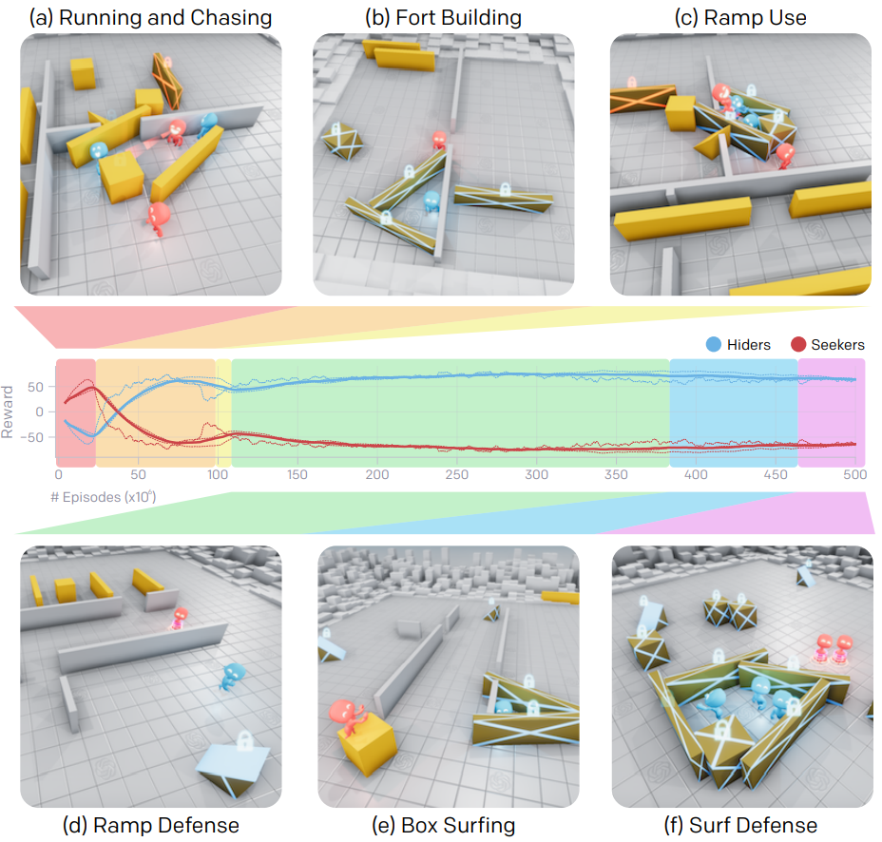
Time for Policy Transition between phases
(OpenAI method)
  380 million episodes for terminal policy
    25 million episodes for transition from 'Running and Chasing' to 'Fort Building'
    75 million episodes for transition from 'Fort Building to Ramp Use'
    10 million episodes for transition from 'ramps' phase to 'ramp defense' phase
    270 million episodes for final transition from 'ramp defense' to 'box surfing' stage

Slide 17
Next Steps
Creating our own policies
  Targeting policy transition with various levels of seeded curriculum
  Optimal curricula should take fewer episodes to reach the next significant phase of policy
Only Hider agent able to learn
  Seeker agent has fixed behavior as seeded with policy at the moment of phase transition
  We know that the improving (learning) hider policy will be tested against opposition of constant difficulty

